Slide 1
Chat Application using Interprocess Communication
OPERATING SYSTEMS LAB PROJECT
Assigned TA: Shipra Shukla

Slide 2
Group Members
Rachit Rahul Mishra (17JE003017)
Samyak Singh (17JE003024)
Vipul Bandi (17JE003026)
Sandesh Sinha (17JE003038)
Sandeep Sheela (17JE003048)
Avi Sahney (17JE003050)
Navya Srivastava (17JE003052)
Vipin Prakash (17JE003061)
Thakur Ashutosh Suman (17JE003067)
Selling your idea

Slide 3
PROBLEM STATEMENT
Title: Develop a chat application using Interprocess Communication.
Use any one of the methods to implement IPC and develop a chat application which can handle multiple clients.
Multiple clients should also simultaneously be able to chat with the server.
The client/user also must be able to see his/her message history.

Slide 4
Inter-Process Communication

Slide 5
A process can be of two types namely Independent processes and Cooperating processes. An independent process is not affected by the execution of other processes while a co-operating process can be affected by other executing processes.
Inter-process communication (IPC) is a mechanism which allows processes to communicate with each other and synchronize their actions. The communication between these processes can be seen as a method of co-operation between them. Processes can communicate with each other using these two ways:
Shared Memory
Message Passing

Slide 6
We have used the concept of shared memory for Inter Process Communication in our project.

Slide 7
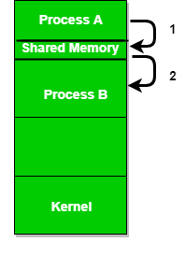
Shared Memory Concept
Shared Memory is an efficient means of passing data between programs. One program will create a memory portion which other processes (if permitted) can access. Once created, a shared segment can be attached to a process address space using shmat(). It can be detached using shmdt().

Slide 8
OUR APPROACH

Slide 9
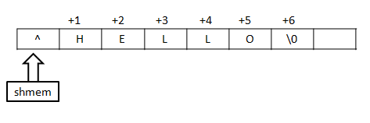
Sending and receiving messages:
The problem statement requires the server to handle multiple clients messages and communicate with them. We have designed a system where messages of multiple clients are displayed at the server’s end and the server can respond to them. In this system, the server reads the message once a client writes and then waits for another client to write. If no client writes to the shared memory location in a given amount of time the server again takes the control. The message written by the server is displayed to all the clients. The way message is written is given below.

Slide 10
Reading the message history:
When the server reads the messages of different clients, it also stores these messages to a text file which clients can access to see their message history. Each client has its own message history text file and can access only that file. The message history can only be displayed after the chatting connection has been closed.

Slide 11
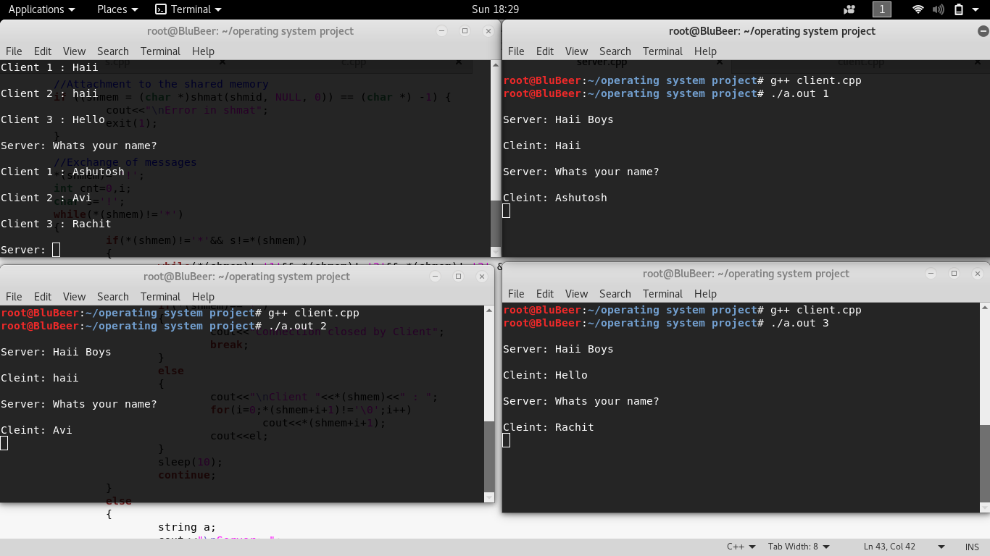
OUTPUT

Slide 12
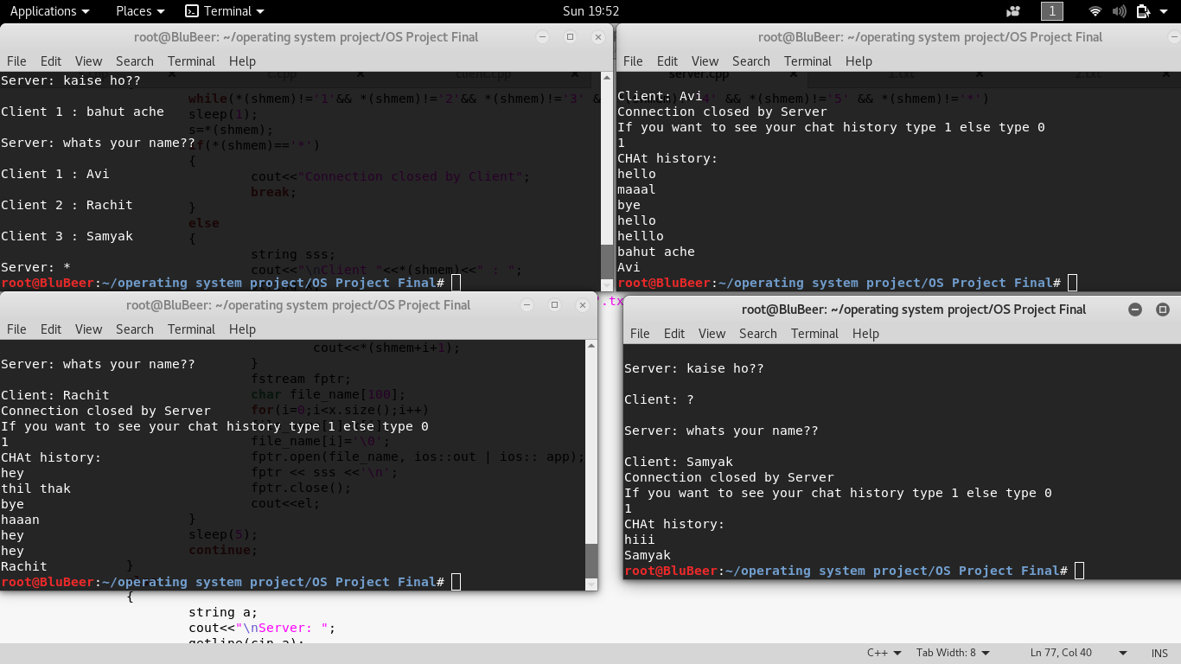
OUTPUT

Slide 13
Thank You

